Slide 1
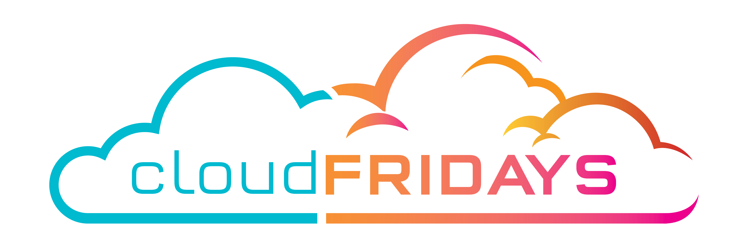
The Differences Between SaaS, PaaS, IaaS
Warren du Toit and Jody Roberts

Slide 2
Why Cloud
Scalability. On-premises solutions are rather difficult to scale, as the type of hardware needed depends on your application’s demands. If your app experiences heavy traffic, you might need to significantly upgrade on-premises hardware. This problem doesn’t exist with a cloud service, which you can quickly scale up or down with a few clicks. Cloud services are a perfect solution for handling peak loads. With cloud-based services, businesses can use whatever computing resources they need.
Cost-effectiveness. Cloud computing removes hardware expenses, as hardware is provided by a vendor. There’s no need to buy, install, configure, and maintain servers, databases, and other components of your runtime environment. Moreover, using cloud-based solutions, you pay only for what you use, so if you don’t need extra resources you can simply scale down and not pay for them.
Immediate availability. Cloud solutions are available as soon as you’ve paid for them, so you can start using a cloud service right away. There’s no need to install and configure hardware.
Performance. Cloud companies equip their data centers with high-performance computing infrastructure that guarantees low network latency for your applications.
Security. Cloud infrastructure is kept in safe data centers to ensure a top level of security. Data is backed up and can easily be recovered. Moreover, cloud vendors ensure the security of your data by using networking firewalls, encryption, and sophisticated tools for detecting cybercrime and fraud.

Slide 3
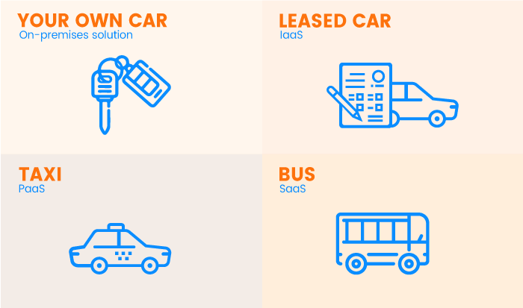
Our Options

Slide 4
Our Options
On-premises IT infrastructure is like owning a car. When you buy a car, you’re responsible for its maintenance, and upgrading means buying a new car.
IaaS is like leasing a car. When you lease a car, you choose the car you want and drive it wherever you wish, but the car isn’t yours. Want an upgrade? Just lease a different car!
PaaS is like taking a taxi. You don’t drive a taxi yourself, but simply tell the driver where you need to go and relax in the back seat.
SaaS is like going by bus. Buses have assigned routes, and you share the ride with other passengers.

Slide 5
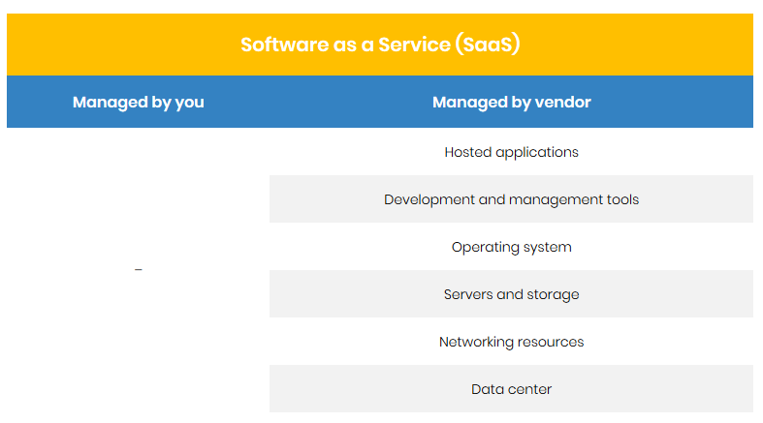
What is SaaS

Slide 6
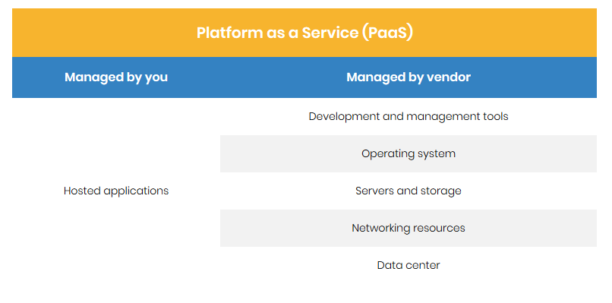
What is PaaS

Slide 7
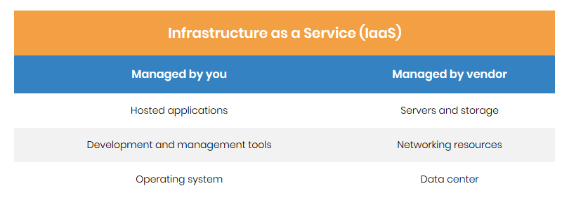
What is IaaS

Slide 8
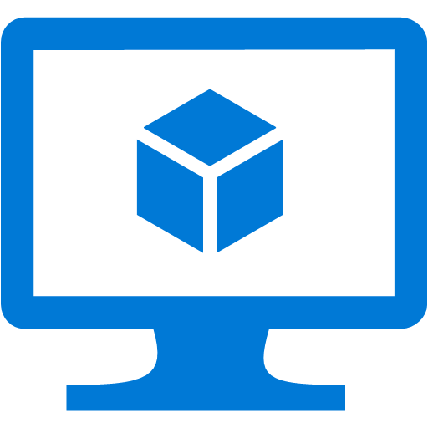
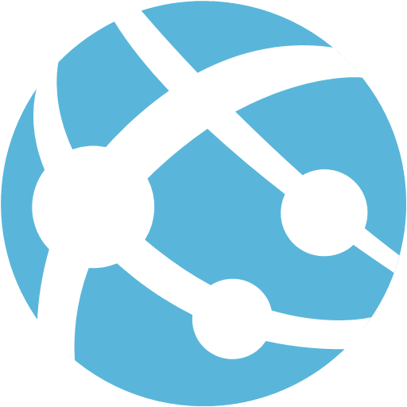
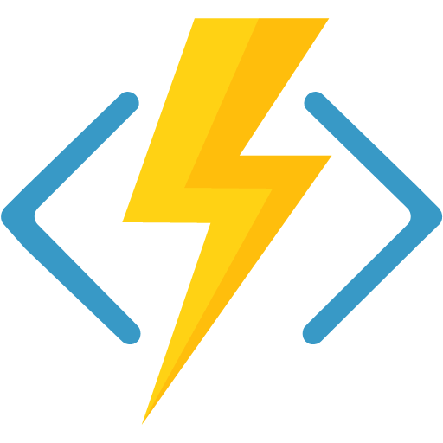
Compute Service Types
Infrastructure as a service (IaaS)
Platform as a Service (PaaS)
Functions as a service (FaaS)
Notes:
On Azure this is broken down into three main categories,
(Click)
Infrastructure as a service (IaaS).
With IaaS, you provision VMs along with associated network and storage components. Software and applications are then deployed onto those VMs. IaaS is the closest compute model to a traditional on-premises environment, except that Microsoft manages the infrastructure. You still manage the individual VMs.
(Click)
Platform as a Service (PaaS) is a managed hosting environment where you deploy applications and other resources without managing the VMs or networking resources. App services is a good example, where you simply set up the resource and deploy an application into it and Azure takes care of provisioning and updating VMs in the background for you.
(Click)
Functions as a service (FaaS) goes further in that you do not administer the compute resources and deploy into a hosting environment, you simply deploy your code, and the service automatically runs it. These services use a serverless architecture, and seamlessly scale up or down to whatever level necessary to handle the traffic. Azure Functions are a FaaS service.

Slide 9
Azure Compute Options
Virtual Machines (VMs)
App Service
Service Fabric
Azure Kubernetes Service
Azure Container Instances
Azure Functions
Azure Batch
Cloud Services
Notes:
Virtual Machines are an IaaS service, allowing you to deploy and manage VMs inside a virtual network (VNet).
App Service is a managed PaaS offering for hosting web apps, mobile app back ends, RESTful APIs, or automated business processes.
Service Fabric is a distributed systems platform that can run in many environments, including Azure or on premises. Service Fabric is an orchestrator of microservices across a cluster of machines.
Azure Kubernetes Service manages a hosted Kubernetes service for running containerized applications.
Azure Container Instances offer the fastest and simplest way to run a container in Azure, without having to provision any virtual machines and without having to adopt a higher-level service.
Azure Functions is a managed FaaS service.
Azure Batch is a managed service for running large-scale parallel and high-performance computing (HPC) applications.
Cloud Services is a managed service for running cloud applications. It uses a PaaS hosting model.

Slide 10
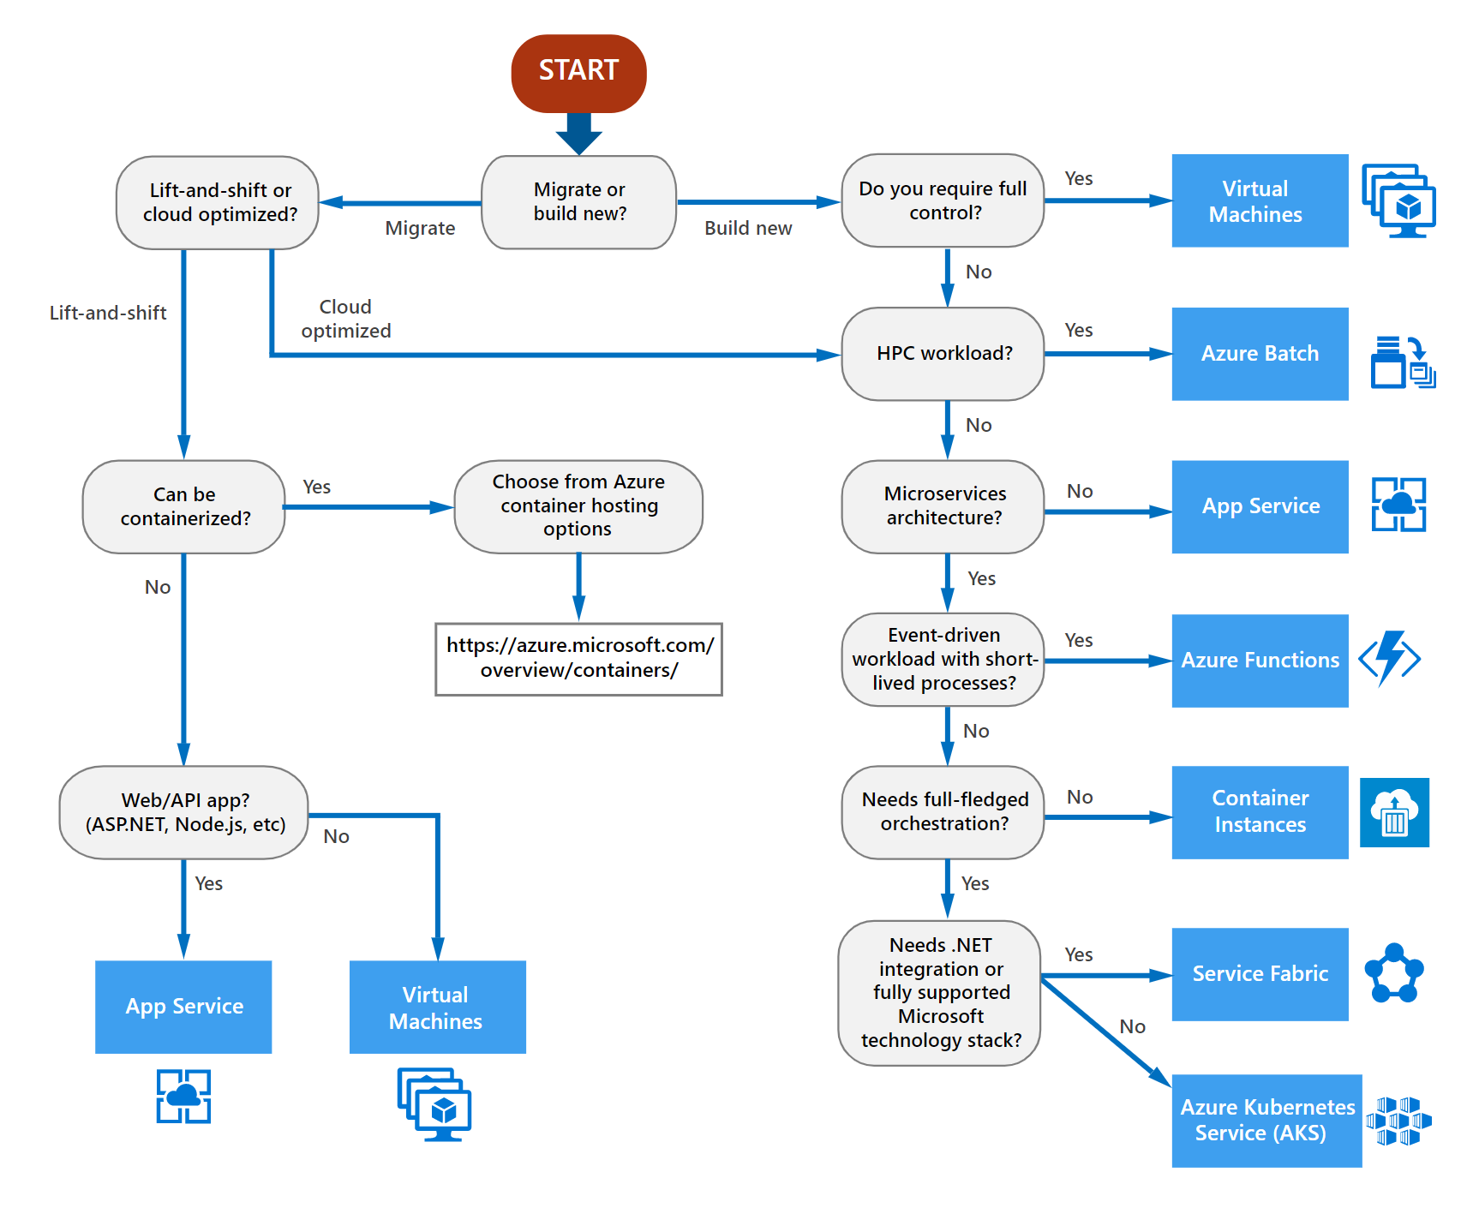
Choosing Compute
Evaluate each workload
Solutions may contain multiple compute services

Slide 11
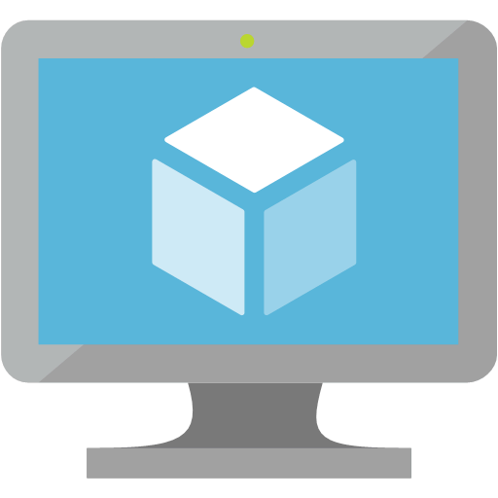
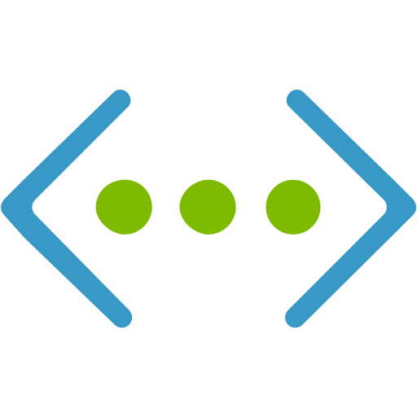
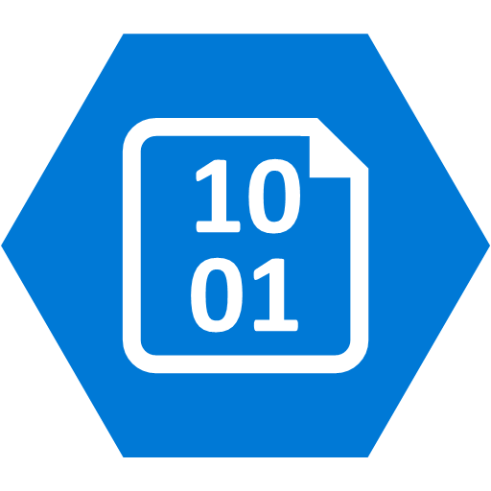
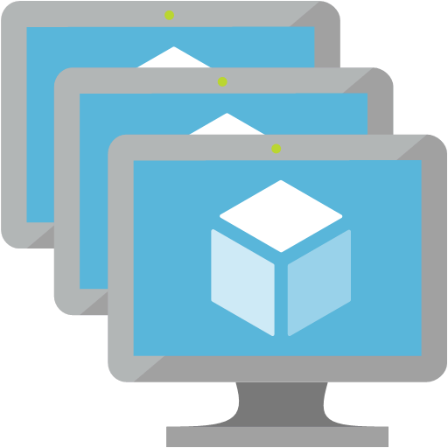
VM Architecture Components
Compute Family
Network
Storage
Availability
Notes:
Azure IaaS consists of compute, storage and networking. Compute and storage are scalable independently of each other. High availability is achievable in Azure IaaS as long as certain pre-requisites are followed. SLA’s are provided in Azure when High Availability is implemented. We shall go into these in the following slides.

Slide 12

Choosing the Right VM Type
Virtual Machines
VM Scale Sets
Deploy and manage using the Azure portal, templates, command line or API
Used for workloads that require state (persistent disk, persistent computer names, etc..)
Storage is backed by Azure Storage with magnetic or SSD based storage
Deploy and manage using the Azure portal, templates, command line or API
Used for deploying large numbers of identical VMs
Big compute, big data, containerized workloads, web farms
Implicitly deploys to an availability set
0-1000 VMs (Platform images) / 0-600 VMs (Custom images with Managed Disks)
Notes:
TO DO: VMSS AZ support
We have the option of using virtual machines in a few ways, as a single unit or as a scaled unit. A single VM can be deployed into a “container” called a resource group. Think of a resource group as a way of organizing how to manage resources like VM’s. We will discuss these more as we proceed through the course. VM’s can be deployed using the Azure Portal, CLI (PowerShell or Azure CLI), JSON templates or API’s. Choosing the right compute deployment is important as there are several ways to deploy application in Azure, if you require control and the ability to customize as well as determine what version of OS etc you run, then a VM is likely the appropriate choice for you. VM storage is provided by an independently scalable storage platform that can be magnetic (standard) or SSD (premium) disk types. Each offer different capabilities.
Scale Sets on the other hand, are deployed as a unit. These can also be deployed using the same mechanisms as VM’s, like the Portal, CLI, API’s and templates. They are useful when deploying a large number of VM’s that do the same role. Examples like Web farms, Big compute and data workloads, containerized applications would suit this deployment methodology. You can deploy up to 1000 VM’s per scale set, more than 100 VM’s is considered a large VM scale set which differences in the way load balancing is handled.

Slide 13

Choose the Optimal Compute Size
A
Av2
B
D
Dv2
Dv3
F
Fv2
Fsv2
ENTRY LEVEL
BURSTABLE
GENERAL PURPOSE
COMPUTE OPTIMIZED
G
Ev3
M
L
NC
NV
NCv2
ND
H
MEMORY OPTIMIZED
STORAGE OPTIMIZED
GRAPHICS INTENSIVE
HPC
HANA
PURPOSE-BUILT FOR
SAP HANA (= dedicated physical machines)
Some families support SSD and will append a “S” to their name, though compute costs are identical
Notes:
Virtual Machines in Azure support many different operating systems, both from Microsoft as well as several distributions of Linux including Red Hat, Oracle, CentOS, and Ubuntu. Also there are several series of VMs offering different sizes in each series. The sizes indicate configurations such as how many processor cores and how much RAM is supported, as well as how many data disks can be attached. Certain series of VMs support fast, SSD-based disk, for when the workload requires a high disk IO capability and low latency. These series have an 'S' in the designation. The series of VMs have targeted uses cases, some of them being quite specialized. We will look at these use cases in the next few slides.
https://azure.microsoft.com/en-us/pricing/details/virtual-machines/linux/

Slide 14
Performance Considerations
SKU Family | ACU/Core
A0 | 50
A1-7, All A_V2 | 100
A8-A11 | 225 *
D/DS 1-14 | 160
D/DS 1-15v2 | 210 - 250 *
D/Ds_v3 | 160-190 * **
E/Es_v3 | 160-190* **
F/Fs 1-F16 | 210 – 250 *
G/GS 1-5 | 180 - 240 *
H | 290 – 300 *
L4s-L32s | 180-240 *
M | 160-180 **
Azure Compute Unit (ACU) provides a way of comparing CPU performance of Azure VMs
Scale Starts with a Standard A_1 being 100 ACU
Example:
G1-G5 are 180% to 240% Faster than A1 – A4s
* Use Intel® Turbo technology to increase CPU frequency
** Hyper-Threaded
Notes:
Microsoft has created the concept of the Azure Compute Unit (ACU) to provide a way of comparing compute (CPU) performance across Azure SKUs.
This will help you easily identify which SKU is most likely to satisfy your performance needs.
ACU is currently standardized on a Small (Standard_A1) VM being 100 and all other SKUs then represent approximately how much faster that SKU can run a standard benchmark.

Slide 15
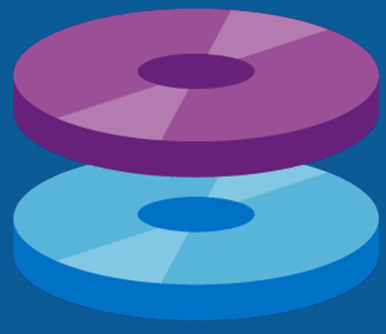
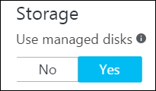
Managed Disks
Azure manages distribution of disks in storage for scale and availability
Supports Premium or Standard storage
Granular RBAC support
Grant/deny access to operations, such as read, delete, export and retrieving a Shared Access Signature
Disk Snapshots (full disk copy)
Read-only copy of a disk at a point in time.
Independent of source disk; use to create new managed disks
Supported with Azure Backup
Alternative: Unmanaged disks (not recommended)
Notes:
Storage in Azure is scaled independently of compute. Managed disks reduces management overhead of traditional storage accounts by automatically managing distribution across storage scale units. This ensures that customers do not run into the scale limitations of traditional storage accounts, and it also ensures that the failure of a storage scale set cannot impact all VMs provisioned in Availability Sets. Other benefits include more robust support for RBAC. For example, if you wanted a group to be able to copy a managed disk to a storage account, you can grant them the ‘export’ operation. Managed disks also support the creation of full-disk snapshots, and the use of Azure Backup to protect your VMs. Unmanaged disks require you to manage storage accounts and the limits imposed by them.

Slide 16
Disk Configuration Best Practices
Use Managed Disks for additional availability and simplified capacity planning
Check disk number, IOPS and throughput limits for your planned VM size
Max IOPS per VM: 80,000 (GS5 VM)
Max throughput per VM: 2,000 MB/s (GS5 VM)
Implement RAID 0 (disk striping with no parity) or use Storage Spaces on Windows Server 2012+ (recommended with 1 channel per disk) to group multiple data disks into a larger volume.
Larger capacity
Higher IOPs
Consider disk caching for workloads that support it
ReadOnly or ReadWrite
Consider size of instance SSD based resource disk when selecting Family & Size
Notes:
To gain faster IO throughput in Standard Storage or to have larger data volumes, OS disks size limit is 2TiB
Storage Spaces is recommended for Windows
You can chase workloads that support them.
Also some VMs have a SSD that is local to the machine. Note that DS and GS allow for persistent SSD as the D: drives.
E: drive in Windows should not be used – maybe allocated to DVD on some hardware

Slide 17
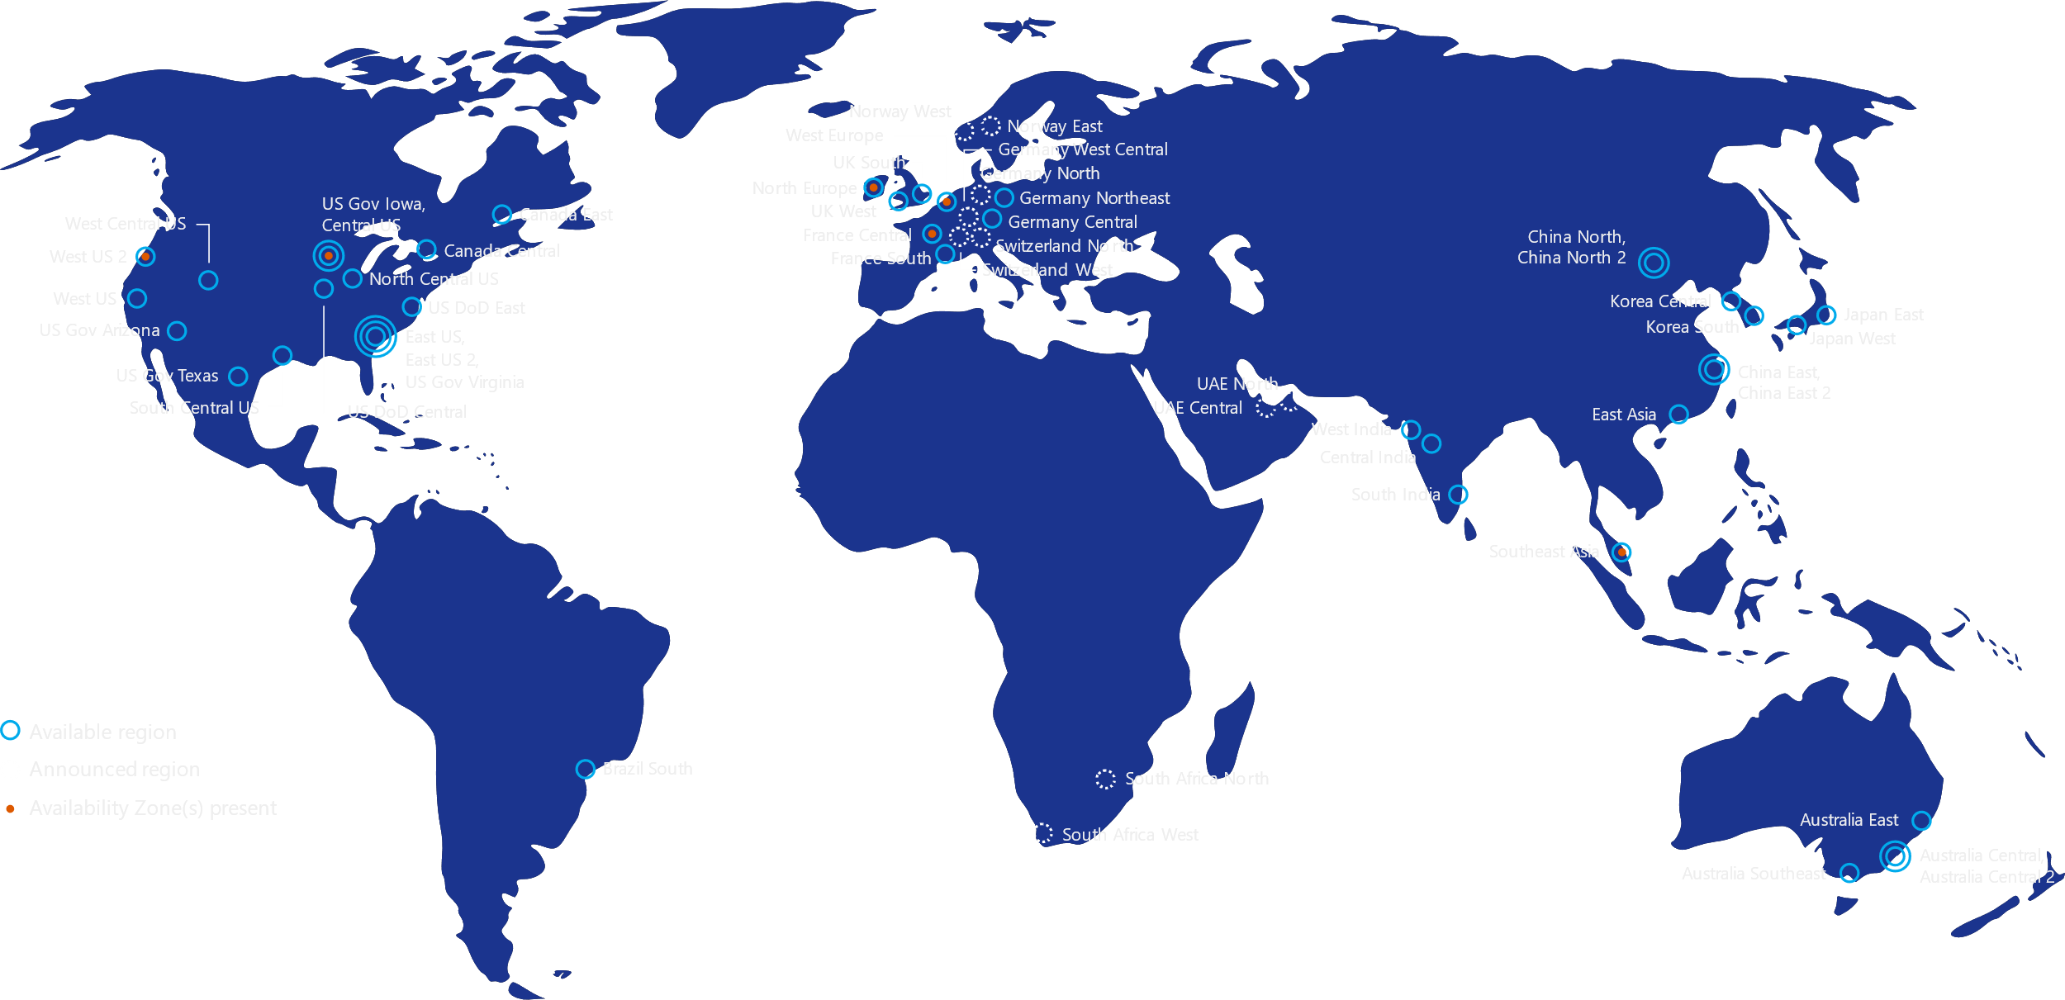
Azure Regions
54 regions, many with multiple data centers
Connected by the Microsoft Backbone, one of the top 3 networks in the world
China Operated by 21Vianet
Germany Operated by Deutsche Telekom
Notes:
Azure regions are a set of datacenters deployed within a latency-defined perimeter and connected through a dedicated regional low-latency network.

Slide 18
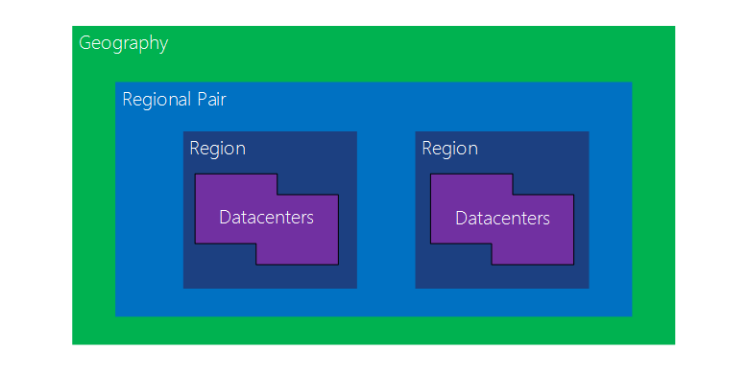
Regional Pairing
Each Region has a “Sister” Region
Physical isolation
Platform-provided replication
Region recovery order
Sequential updates
Data residency
Notes:
Another benefit of the global footprint of Azure is the ability to deploy your workloads/services in a geographically redundant way. Azure has the concept of 'region pairs' which Microsoft recommends leveraging during multi-geography deployments. Region pairs help to ensure adequate isolation boundaries, which means if a natural disaster takes down an entire region, the 'sister' region should not be impacted. Also, when enabled by the customer (i.e. not automatically), various data replication capabilities in the platform leverage the concept of region pairs, automatically selecting the 'sister' region as a replication target. All region pairs (with the exception of Brazil, Southeast Asia and East Asia) are in the same geo-political area, helping to ensure data sovereignty compliance. One other key consideration about region pairs is region recovery order. In the event of a broad outage, recovery of one region is prioritized out of every pair, helping to ensure rapid recovery of a service deployed across region pairs. Finally, system updates to Azure are never deployed to Azure regions at the same time. This minimizes downtime, the effect of bugs, and logical failures in the rare event of a bad update.

Slide 19
Choosing Azure Region(s)
Ensure the services you need are available in the regions
Network Latency to the Azure Datacenter and customer location(s)
Primary consumers of services and their location
Region Pairs should be used for multi-region deployments
Business requirements for data residency
Notes:
When choosing the Azure region or regions that you will deploy to, be certain to consider which Azure services your solution will require. Not all Azure services are available in every region. Also, consider the network latency when choosing a region. Ideally, you want the workload to be as close to the end users as possible to improve performance. Don't forget to keep paired regions in mind, as this will impact resiliency and recoverability. Pricing varies between Azure regions and depending on workloads, savings could be made deploying resources in other regions, subject to regulatory, privacy and performance requirements.

Slide 20

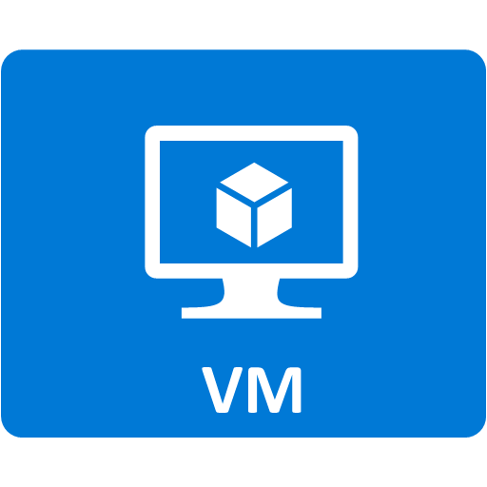
Availability Options
VIRTUAL NETWORK
There are three options backed by an SLA for IaaS VMs:
99.99% when deploying into Availability Zones (in Preview)
99.95% when using multiple VMs and Availability Sets
99.9% when using Single VMs (must use Premium Storage)
ZONE 1
ZONE 2
ZONE 3
AVAILABILITY ZONE – 99.99% SLA
AVAILABILITY SET – 99.95% SLA
SINGLE VM – 99.9% SLA
Notes:
Availability zones (preview) allow for low latency connectivity of applications between datacenters. They are not globally available, so check the region that you use. AV sets will be discussed in the next slide.

Slide 21
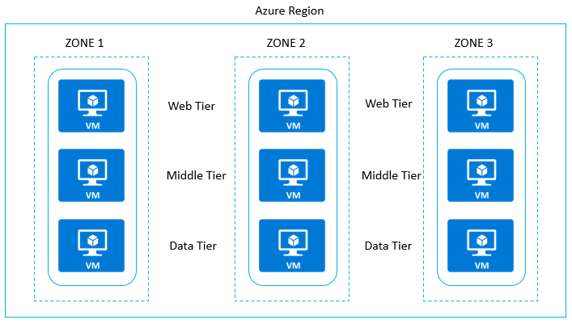
Availability Zones
99.99% availability
Physically separated
Independent power, networking, and cooling
Close enough to provide regional latency for synchronous data replication
Assign VMs or scale sets to specific zones, or spread across zones
Zone redundant load balancer and public IP address
Check for support in your planned regions
Notes:
Offering designed to protect apps from datacenter failures. Unique physical locations each with 1 or more datacenters with independent power, cooling and networking. Each AV region has a minimum of 3 separate zones in each region it is available in. Each VM is deployed in its own Fault Domain and Update Domain. Support synchronous replication with AV Zone and Asynchronous across regions. Not available across all regions or for all services. No extra cost for AV Zones but will result in additional charges for inter-Availability zone VM-VM data transfer charges.
https://docs.microsoft.com/en-us/azure/availability-zones/az-overview

Slide 22
Azure App Service
A PaaS Application platform for delivering modern enterprise apps across cloud, on-prem, and mobile devices.
Delivered as an integrated offering that includes features and capabilities from a number of existing Azure services.
Enterprise Grade Apps
Fully Managed Platform
High Productivity Development
Notes:
Azure App Service is a Platform-as-a-Service, or PaaS, offering in Microsoft Azure that provides an integrated cloud app platform for delivering modern enterprise apps across cloud and mobile devices. You can create web and mobile apps for any platform or device. Integrate you apps with SaaS services, connect with on-premises applications, and automate your business processes. Azure App Service runs your apps on fully managed virtual machines with your choice of shared or dedicated server resources.

Slide 23







An end-to-end Application PaaS Platform
SOLUTIONS
eCommerce
Branded website
LOB App
Custom apps
API/Services/ISV
SERVICES
Web Apps
Mobile Apps
Logic Apps
Notification Hubs
API Apps
Web App for Containers
Azure
Functions
And more…
PLATFORM
App Service
Fully Managed Platform • Developer Experience • Enterprise Grade
Notes:
Azure App Service as a Platform as a Service (or PaaS) platform is the foundation for a number of other Azure services built to help you build, host, and manage applications in the cloud. The core pieces of these services is the Azure Web App service, which we’ll discuss in further detail shortly, and it extends out to a few others as well:
API Apps helps you host and manage API in the cloud
Mobile Apps helps you host and manage the backend data API for native mobile apps running on devices,
Web Apps for Containers enables you to use a container model with Azure App Service
Logic Apps enables code free development of business process and workflow automation to connect and integrate disparate system more easily
Azure Functions offers a Serverless compute that further abstracts things out so you can focus more on the business logic needed, and less on the plumbing code that every application needs to be hosted
Notification Hubs is a messaging services that compliments App Service, enabling the ability to integrate Native Mobile Push Notifications into your applications
And there are many other services within Azure that also compliment App Service very nicely as well.
Using these various offerings of Azure App Service, you can host just about any custom application, or even OSS applications your organization needs.

Slide 24
Offering Differentiated Benefits
Enterprise-grade apps
Fully managed platform
High productivity development
Global data center footprint
Hybrid support
Built-in auto scale and load balancing
High availability with auto-patching
.NET, Java, PHP, Node,
Ruby, and Python
Staging and deployment
AAD integrated
Secure + compliant
Reduced operations costs
Backup and recovery
Testing in production
App gallery marketplace

Slide 25
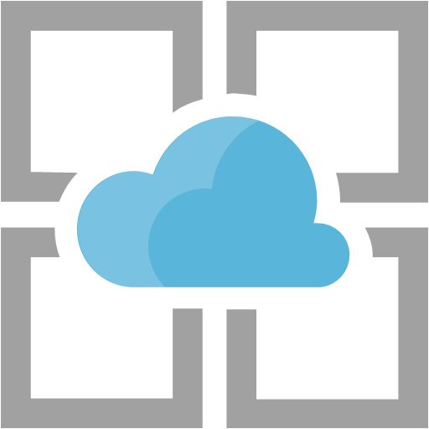
App Service Plans
Defines the underlying Managed VM
Windows or Linux
One or more App Service Plans can be used
Single Web App in App Service Plan
App Service Plan shared by multiple Web Apps
Each Web App can only be associated with a single App Service Plan at a time
Notes:
In App Service, an app runs in an App Service plan. An App Service plan defines a set of compute resources for a web app to run. These compute resources are analogous to the server farm in conventional web hosting. One or more apps can be configured to run on the same computing resources (or in the same App Service plan).
When you create an App Service plan in a certain region (for example, West Europe), a set of compute resources is created for that plan in that region. Whatever apps you put into this App Service plan run on these compute resources as defined by your App Service plan.

Slide 26
App Service Plans
Service tier to deploy Azure App Service applications to
Free
Shared
Basic
Standard
Premium
PremiumV2
Isolated
Consumption
Only available to Azure Functions
Notes:
The pricing tier of an App Service plan determines what App Service features you get and how much you pay for the plan. There are a few categories of pricing tiers:
Shared compute: Free and Shared, the two base tiers, runs an app on the same Azure VM as other App Service apps, including apps of other customers. These tiers allocate CPU quotas to each app that runs on the shared resources, and the resources cannot scale out.
Dedicated compute: The Basic, Standard, Premium, and PremiumV2 tiers run apps on dedicated Azure VMs. Only apps in the same App Service plan share the same compute resources. The higher the tier, the more VM instances are available to you for scale-out.
Isolated: This tier runs dedicated Azure VMs on dedicated Azure Virtual Networks, which provides network isolation on top of compute isolation to your apps. It provides the maximum scale-out capabilities.
Consumption: This tier is only available to Azure Function Apps. It scales the functions dynamically depending on workload.
NOTE: App Service Free and Shared (preview) hosting plans are base tiers that run on the same Azure VM as other App Service apps. Some apps may belong to other customers. These tiers are intended to be used only for development and testing purposes.
The new PremiumV2 pricing tier provides Dv2-series VMs with faster processors, SSD storage, and double memory-to-core ratio compared to Standard tier. PremiumV2 also supports higher scale via increased instance count while still providing all the advanced capabilities found in the Standard plan. All features available in the existing Premium tier are included in PremiumV2.
Similar to other dedicated tiers, three VM sizes are available for this tier:
Small (one CPU core, 3.5 GiB of memory)
Medium (two CPU cores, 7 GiB of memory)
Large (four CPU cores, 14 GiB of memory)

Slide 27
App Service Environment
Feature of Azure App Service
Provides a fully isolated and dedicated environment
Can host:
Windows web apps
Linux web apps
Mobile apps
Functions
Appropriate for workloads that require:
Very high scale
Isolation and secure network access
High memory utilization
Notes:
Earlier we saw there is an isolated tier available for App Service Plans. In order to run an isolated tier, we first create an App Service Environment.
The Azure App Service Environment is an Azure App Service feature that provides a fully isolated and dedicated environment for securely running App Service apps at high scale. This capability can host your:
Windows web apps
Linux web apps
Docker containers
Mobile apps
Functions
App Service environments (ASEs) are appropriate for application workloads that require:
Very high scale.
Isolation and secure network access.
High memory utilization.
Customers can create multiple ASEs within a single Azure region or across multiple Azure regions. This flexibility makes ASEs ideal for horizontally scaling stateless application tiers in support of high RPS workloads.
ASEs are isolated to running only a single customer's applications and are always deployed into a virtual network. Customers have fine-grained control over inbound and outbound application network traffic. Applications can establish high-speed secure connections over VPNs to on-premises corporate resources.

Slide 28
App Service Environment – Dedicated environment
An ASE is dedicated exclusively to a single subscription
Can host 100 App Service Plan instances
Could be 100 instances in a single App Service Plan
Could be 100 single-instance App Service Plans
Anything in between!
Composed of front ends and workers
Front ends are responsible for HTTP/HTTPS termination and load balancing
Front ends are automatically added as the ASE scales out
Workers are roles that host customer apps
Workers come in three fixes sizes:
One vCPU / 3.5 GB RAM
Two vCPU / 7 GB RAM
Four vCPU / 14 GB RAM
Notes:
An ASE is dedicated exclusively to a single subscription and can host 100 App Service Plan instances. The range can span 100 instances in a single App Service plan to 100 single-instance App Service plans, and everything in between.
An ASE is composed of front ends and workers. Front ends are responsible for HTTP/HTTPS termination and automatic load balancing of app requests within an ASE. Front ends are automatically added as the App Service plans in the ASE are scaled out.
Workers are roles that host customer apps. Workers are available in three fixed sizes:
One vCPU/3.5 GB RAM
Two vCPU/7 GB RAM
Four vCPU/14 GB RAM
Customers do not need to manage front ends and workers. All infrastructure is automatically added as customers scale out their App Service plans. As App Service plans are created or scaled in an ASE, the required infrastructure is added or removed as appropriate.
There is a flat monthly rate for an ASE that pays for the infrastructure and doesn't change with the size of the ASE. In addition, there is a cost per App Service plan vCPU. All apps hosted in an ASE are in the Isolated pricing SKU.

Slide 29
App Service Environment – Virtual network support
ASE is a deployment of the App Service directly into a customer’s Azure resource manager virtual network
ASE always exist in a subnet of a virtual network
Use the security features of virtual networks to control inbound and output network communication
ASE can be either internet-facing with a public IP or with only an Azure internal load balancer address
Network Security Groups restrict inbound network communications to the subnet where the ASE resides
If the virtual network has a VPN connection to an on-premises network, the apps in the ASE can access the on-premises resources
Notes:
The ASE feature is a deployment of the Azure App Service directly into a customer's Azure resource manager virtual network. An ASE always exists in a virtual network, and more precisely, within a subnet of a virtual network. You can use the security features of virtual networks to control inbound and outbound network communications for your apps.
An ASE can be either internet-facing with a public IP address or internal-facing with only an Azure internal load balancer (ILB) address.
Network Security Groups restrict inbound network communications to the subnet where an ASE resides. You can use NSGs to run apps behind upstream devices and services such as WAFs and network SaaS providers.
Apps also frequently need to access corporate resources such as internal databases and web services. If you deploy the ASE in a virtual network that has a VPN connection to the on-premises network, the apps in the ASE can access the on-premises resources. This capability is true regardless of whether the VPN is a site-to-site or Azure ExpressRoute VPN.

Slide 30
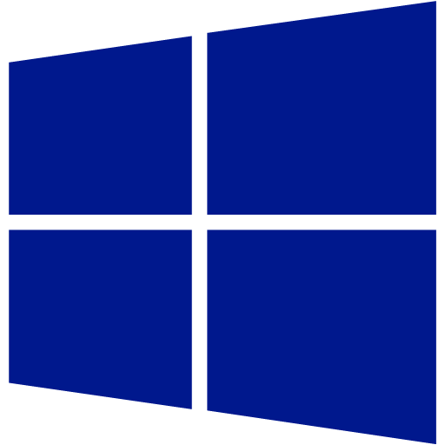
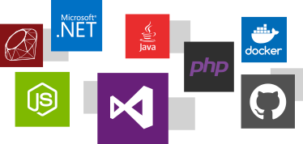
App Service on Windows
Language support
.NET Framework
PHP
Java
Python
Node.js
Classic ASP
Custom FastCGI Handler
Notes:
With App Service on Windows you can deploy applications built on Classic ASP, ASP.NET, PHP, Python, Java, and Node.js. You do not have to worry about the runtime itself because it is built in to the platform.
Any framework that supports using the FastCGI handler in IIS is also supported.

Slide 31
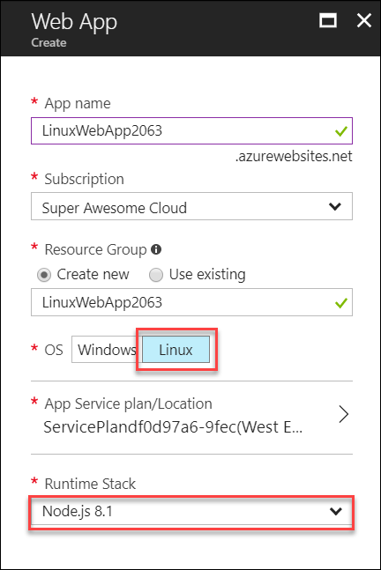
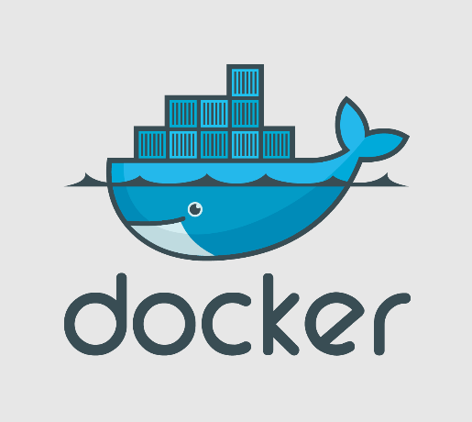
App Service on Linux
Managed Linux VM
Runs on Docker
Runtime Stack
Node.js
PHP
.NET Core
Ruby
Java
Notes:
The App Service on Linux feature, brings Azure App Service to the Linux operating system. These run in a special Linux based App Service Plan, and include built-in support for hosting Web Apps written for Node.js, Php, and .NET Core which are deployed out as Docker Containers internally. To define the platform you need to host your app, simply specify the specific Runtime Stack you require. The platform offers a few different supported versions of Node.js, PHP, .NET Core, Ruby, and Java to pick from.

Slide 32
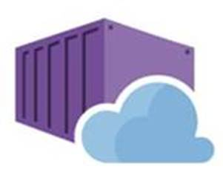
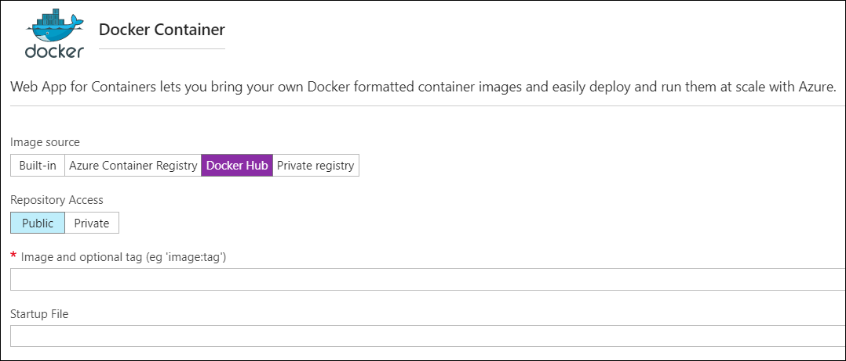
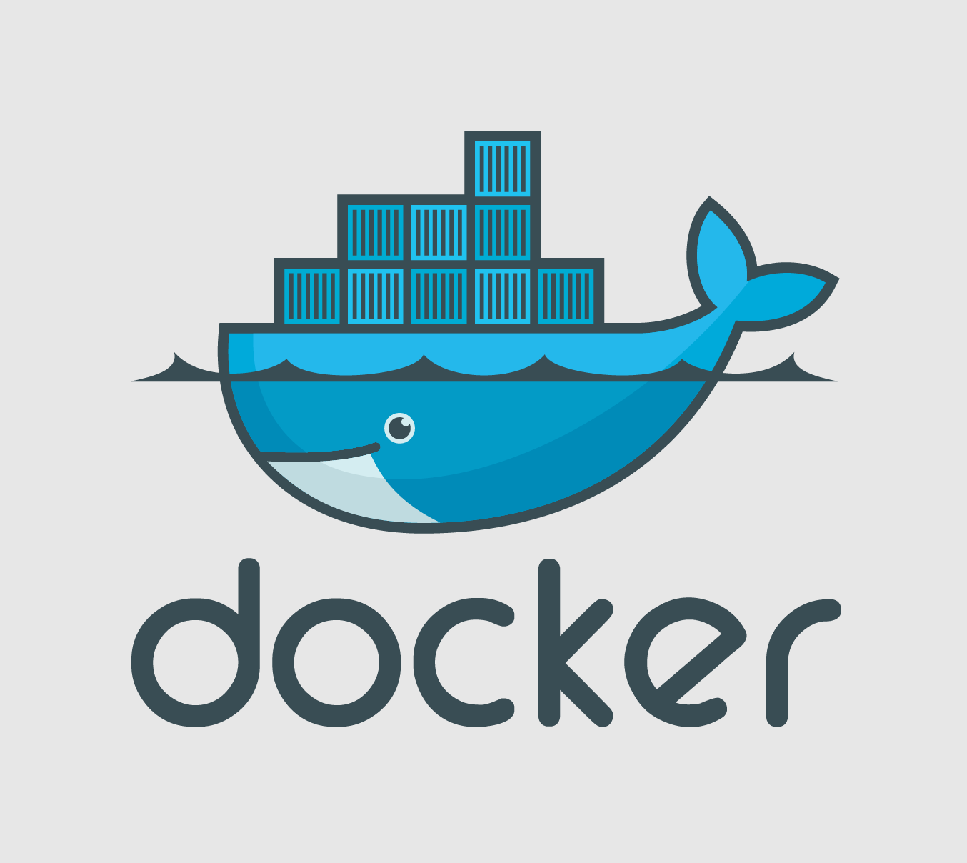
App Service on Containers
Managed Linux VM
Runs on Docker
Image source
Docker Hub
Private Registry
Azure Container Registry
Notes:
The App Service on Containers feature enabled you to use any Docker Image you need as the basis for the managed VM environment that will host your Web App. App Service on Containers is basically the same as App Service on Linux with the exception that you specify the base Docker Image; rather than choose from a list of pre-built images. You can specify Docker images to pull from Docker Hub (both public and private repos), a Private Registry, or even an instance of the Azure Container Registry service you may be running within your organization.

Slide 33
What is Docker?
World’s leading container platform
Containers are isolated, but share OS and appropriate binaries and libraries
Results in faster deployment, less overhead, easier migration, and faster restarts
Notes:
If you are unfamiliar with Docker, it’s the leading containerization platform. Containers are isolated environments running on a shared host. They are similar to Virtual Machines, in that you can deploy applications and data to them in an isolated, sandboxed manner that protects one container from another running on the same host. However, Containers are lighter weight than VMs, in that each container on a host shares the same Operating System Kernel binaries and libraries; so the container image only needs to specify what to deploy and configure custom on top of the OS foundation.

Slide 34
Azure Container Ecosystem
App Service
Azure Container Registry (ACR)
PaaS
Partner services
Azure services
OpenShift
SQL Database
Azure Kubernetes Service (AKS)
Service Fabric (Mesh & cluster)
Batch
Pivotal Cloud Foundry
Redis Cache
Docker Enterprise Edition
CosmosDB
Virtual kubelet
Mesosphere DC/OS
And more!
Azure Container Instances (ACI)
Azure Virtual Machines
Virtual Machine Scale Sets (VMSS)
IaaS
Azure
Notes:
When we think about a production development or even QA and Dev/Test environments, Azure provides a very open and broad variety of choices, a full container ecosystem in the cloud. Depending on your specific application’s needs there’s probably something here for you.
The products supporting containers that are considered infrastructure are the following:
Azure Container Instances (ACI)
Azure Virtual Machines (with container support)
Azure Virtual Machine Scale Sets (with container support)
Of those three, ACI provides a great benefit in that you don’t need to maintain the underlying operating system, so no need to upgrade or patch.
The products supporting containers that are positioned more in the PaaS level are:
Azure App Service
Azure Service Fabric (Mesh and Cluster)
Azure Kubernetes Service (AKS and ACS)
Azure Batch
We also have Azure Container Registry, which is a highly scalable registry hosted in Azure that you can consume from all the previously mentioned products when registering and deploying your custom container images.
In addition, you can consume other managed services in Azure like Azure SQL Database, Redis Cache, Azure Cosmos DB, etc. from your containers. Of course, there are also third-party solutions/platforms available in the Azure Marketplace like Cloud Foundry and OpenShift where which also allow you to run containers in Azure.

Slide 35
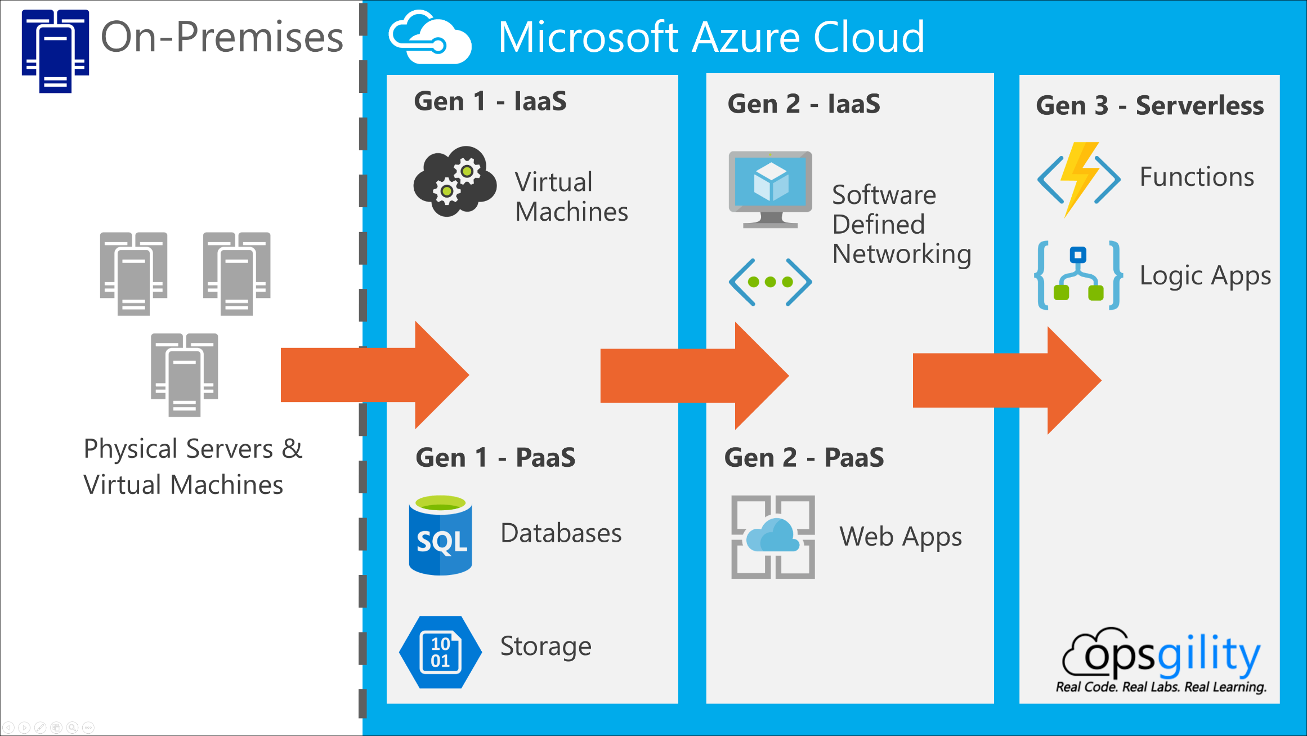
Cloud Evolution

Slide 36
When to Use Serverless?
Stateless
Easier to Scale
Great for Variable or Unpredictable workloads
Great for Very Low or Very High Scale
Focus on Business Logic over Infrastructure
Simplifies complicated architectures and deployments

Slide 37
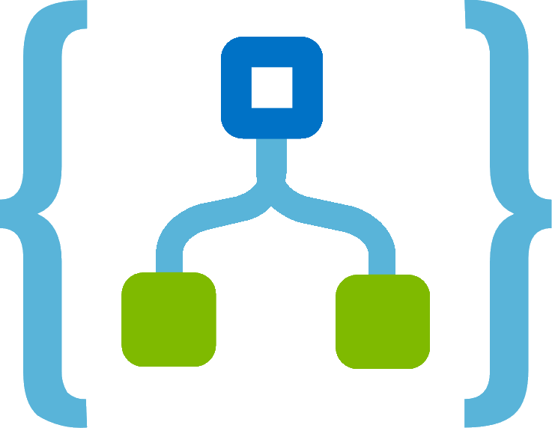
Azure Serverless Platform
Azure Functions
Azure Logic Apps
Serverless Compute
Developer Tooling
Bindings and Triggers
Open Source
Workflow orchestration
Visual designer
100+ pre-built connectors
Functions integration
Storage
Data
Messaging
Other

Slide 38
Azure Functions
Manage your apps instead of infrastructure
Build apps you need using simple, serverless functions that scale to meet demand
Develop your way
Using the language you choose, such as JavaScript, C#, Java, and more
Bind into services
Built-in support to connect to Azure and external services
Notes:
With Azure functions we can easily build the apps we need using simple, serverless functions that scale to meet demand…and we get to use the programming language of our choice…all without having to worry about servers or infrastructure.
We can simply focus on building great apps. We don’t have to worry about provisioning and maintaining servers because Azure Functions provides a fully managed compute platform with high reliability and security. With scale on demand, our code gets the compute resources it needs, when it needs them, which frees us of capacity planning concerns.
We write code only for what truly matters to our business because we can leverage the built in programming model for everything such as communicating with other services, building HTTP-based API, or orchestrating complex workflows. Azure Functions leads us to a microservices-friendly approach for building more scalable and stable applications.
We can write our code in an easy-to-use web-based interface or build and debug locally on our machine with our favorite development tool. We can also take advantage of built-in continuous deployment and use integrated cloud monitoring tools to troubleshoot any issues.

Slide 39
Azure Functions
Bring your own dependencies
NuGet and NPM support
Integrated Security
Protect HTTP-triggered Function with OAuth providers such as Azure AD, Facebook, Google, Microsoft Account
Pay-per-use Pricing
Pay only for time spent running your code
Notes:
With Azure Functions, we can bring our own dependencies because of the support for NuGet and NPM, we can use our favorite libraries.
We also get integrated security with HTTP-triggered functions that are protected with Oauth providers such as Azure Acive Directory, Facebook, Google, Twitter, and Microsoft Accounts.
And one of the most compelling features, in my opinion, is that we pay only for time spent running our code.

Slide 40
Azure Functions Runtime
v1.0
Supports Development and Hosting only in Azure Portal and Windows
Runs on .NET Framework
v2.0
Supports Development and Hosting in Azure Portal, including Windows, Linux, and macOS
Runs on .NET Core; supports all platforms
Open Source on GitHub
Notes:
There are two major versions of the Azure Functions runtime: 1.x and 2.x. The current version where new feature work and improvements are being made is 2.x, though both are supported for production scenarios.
The version 2.x runtime runs on .NET Core 2, which enables it to run on all platforms supported by .NET Core, including macOS and Linux. Running on .NET Core enables cross-platform development and hosting scenarios. By comparison, the version 1.x runtime only supports development and hosting in the Azure portal or on Windows computers.
By default, function apps created in the Azure portal are set to version 2.x. When possible, you should use this runtime version, where new feature investments are being made. If you need to, you can still run a function app on the version 1.x runtime. You can only change the runtime version after you create your function app but before you add any functions.
You may choose to migrate an existing app written to use the version 1.x runtime to instead use version 2.x. Most of the changes you need to make are related to changes in the language runtime, such as C# API changes between .NET Framework 4.7 and .NET Core 2. You'll also need to make sure your code and libraries are compatible with the language runtime you choose. Finally, be sure to note any changes in trigger, bindings, and features highlighted below. For the best migration results, you should create a new function app for version 2.x and port your existing version 1.x function code to the new app.

Slide 41
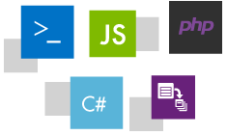
Supported Language
Language | v1.0 Runtime | v2.0 Runtime
C# | GA (.NET 4.7) | GA (.NET Core 2)
JavaScript | GA (Node 6) | GA (Node 8 & 10)
F# | GA (.NET 4.7) | GA (.NET Core 2)
Java |  | Preview (Java 8)
Python | Experimental | N/A
PHP | Experimental | N/A
TypeScript | Experimental
Batch (.cmd, .bat) | Experimental | N/A
Bash | Experimental | N/A
PowerShell | Experimental | N/A
Notes:
https://docs.microsoft.com/en-us/azure/azure-functions/functions-versions#languages

Slide 42

Dual Abstraction
Serverless compute
Abstracts away the compute layer (application and server)
Bindings
Abstract away the code to interact with services
Enables greater focus on Business Logic
Other Services
Business Logic
Serverless PaaS

Slide 43
Platform and Scaling
App Service Plan pricing
Dedicated is the existing App Service plan tiers
Basic, Standard, Premium
Pay based on # of reserved VMs
You’re responsible for scale
Consumption Plan pricing
Pay on number of executions
Platform automatically scales for you
Notes:
Azure Functions runs in two different modes: Consumption plan and Azure App Service plan. The Consumption plan automatically allocates compute power when your code is running. Your app is scaled out when needed to handle load, and scaled down when code is not running. You don't have to pay for idle VMs or reserve capacity in advance.
When you create a function app, you choose the hosting plan for functions in the app. In either plan, an instance of the Azure Functions host executes the functions. The type of plan controls:
How host instances are scaled out.
The resources that are available to each host.
NOTE: You must choose the type of hosting plan during the creation of the function app. You can't change it afterward.

Slide 44
Scaling and Pricing
App Service Plan
Based on App Service Plan
Share single plan with one or multiple apps
Scale out dedicated instances manually or with AutoScale
Billed for dedicated instances, regardless of usage
Consumption Plan
Serverless Compute
Only pay for what you use (GB/s)
Scales dynamically to meet demand

Slide 45
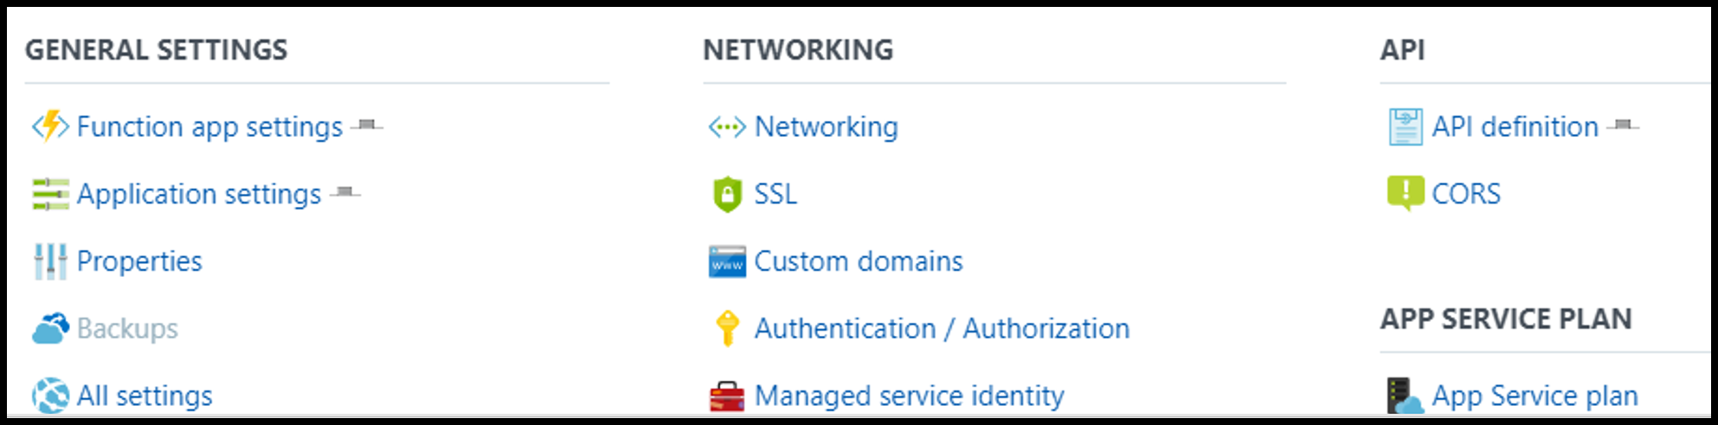
App Service Features
Azure Functions is built and hosted on top of Azure App Service
Features of App Service are available to Azure Function Apps
Both Consumption Plan and App Service Plan pricing

Slide 46
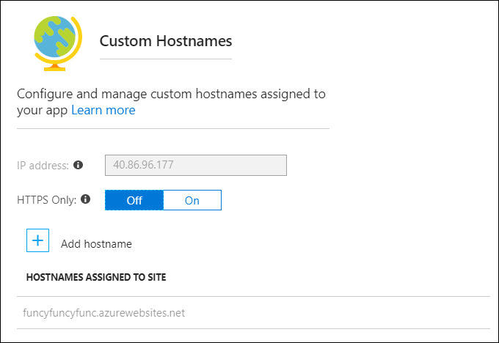
Custom Domains
Configure Custom Domains

Slide 47
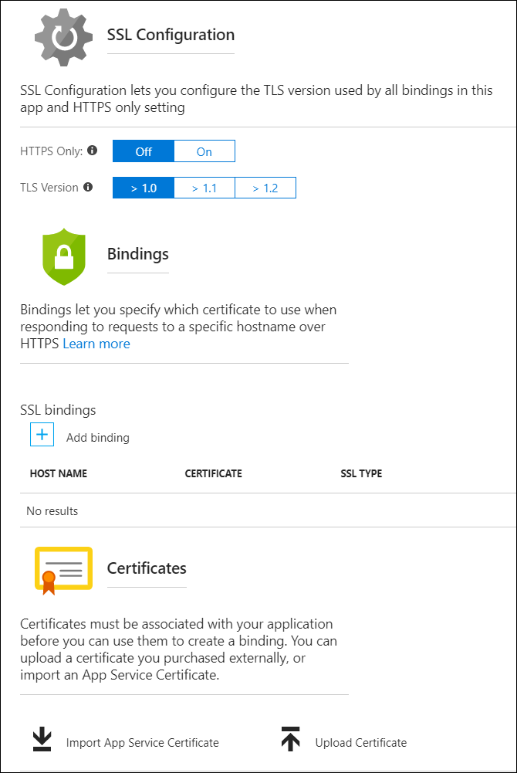
SSL Configuration
Enforce HTTPS Only
Choose TLS Version
Custom Certificates
Custom SSL bindings per Domain and Certificate

